Slide 1
4 Generating Permutations and Combinations
Zhou Xiaoyu zhouxy@seu.edu.cn
room 427, Building of School of Computer Science & Engineering

Slide 2
Introduction
We explore some features of permutations and combinations that are not directly related to counting.
We discuss some ordering schemes for them and algorithms for carrying out these schemes.

Slide 3
4.1 Generating Permutations

Slide 4
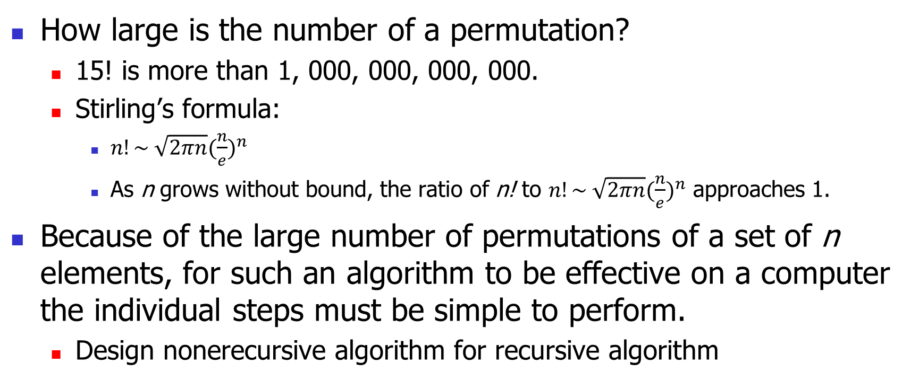
How Large is the Number of a Permutation
How large is the number of a permutation?
15! is more than 1, 000, 000, 000, 000.
Stirling’s formula:
$n!\sim \sqrt{2πn}{(\frac{n}{e})}^{n}$
As n grows without bound, the ratio of n! to $n!\sim \sqrt{2πn}{(\frac{n}{e})}^{n}$ approaches 1.
Because of the large number of permutations of a set of n elements, for such an algorithm to be effective on a computer the individual steps must be simple to perform.
Design nonerecursive algorithm for recursive algorithm

Slide 5
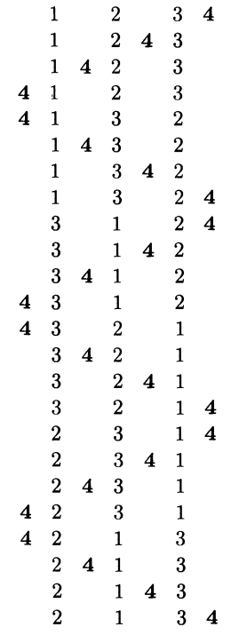

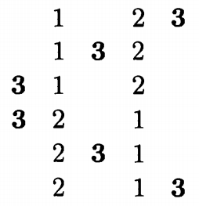
To Generate Permutations of {1, 2, ... , n}
Inductive thinking and recursive algorithm
Problem: How to get a permutation of {1, 2, ... ,n} from a permutation of {1, 2, ... , n - 1}?
Basic Idea: Insert n into a permutation of {1, 2, ... ,n - 1}
Proof: two list of numbers of {1, 2, ... , n} are different iff
their projection on {1, 2, ... , n-1} are different.
otherwise n is inserted at different position of the subsequence projected on {1, 2, ... , n-1}.

Slide 6
An Inductive Observation
given a permutation of {1, 2, ... , n - 1}, there are exactly n ways to insert n into this permutation to obtain a permutation of {1, 2, ... , n}.

Slide 7
To Generate Permutations of {1, 2, ... ,n}
Recursion is not efficient.
Nonrecursive: loop.
Nonrecursive algorithm based on idea of recursion.
Every step should be as simple as possible: spend less time.
Basic Idea: Instead of inserting n after generating all permutations of {1, 2, … , n - 1}, we insert n in the process of generating the permutations of {1, 2, … , n - 1}.

Slide 8
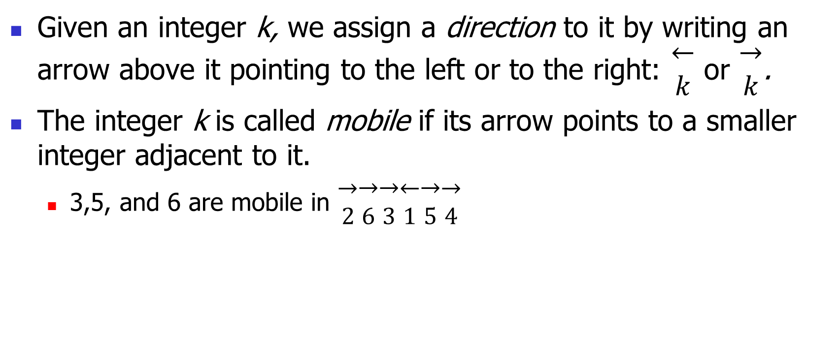
To Generate Permutations of {1, 2, ... ,n}
Given an integer k, we assign a direction to it by writing an arrow above it pointing to the left or to the right: $\begin{matrix}← \\ k\end{matrix}$ or $\begin{matrix}→ \\ k\end{matrix}$.
The integer k is called mobile if its arrow points to a smaller integer adjacent to it.
3,5, and 6 are mobile in $\begin{matrix}→ \\ 2\end{matrix}\begin{matrix}→ \\ 6\end{matrix}\begin{matrix}→ \\ 3\end{matrix}\begin{matrix}← \\ 1\end{matrix}\begin{matrix}→ \\ 5\end{matrix}\begin{matrix}→ \\ 4\end{matrix}$

Slide 9
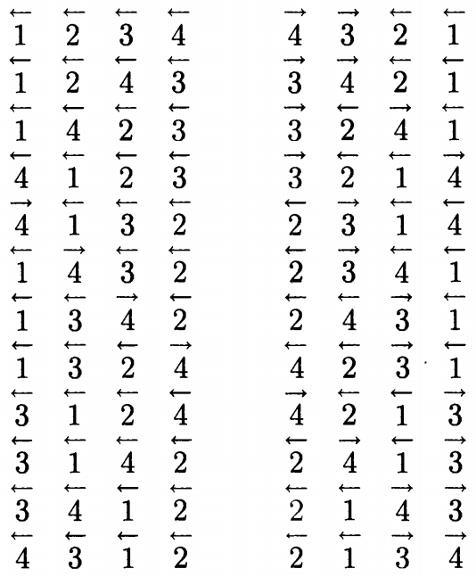

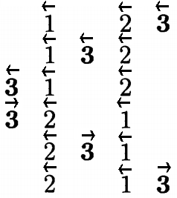

Slide 10
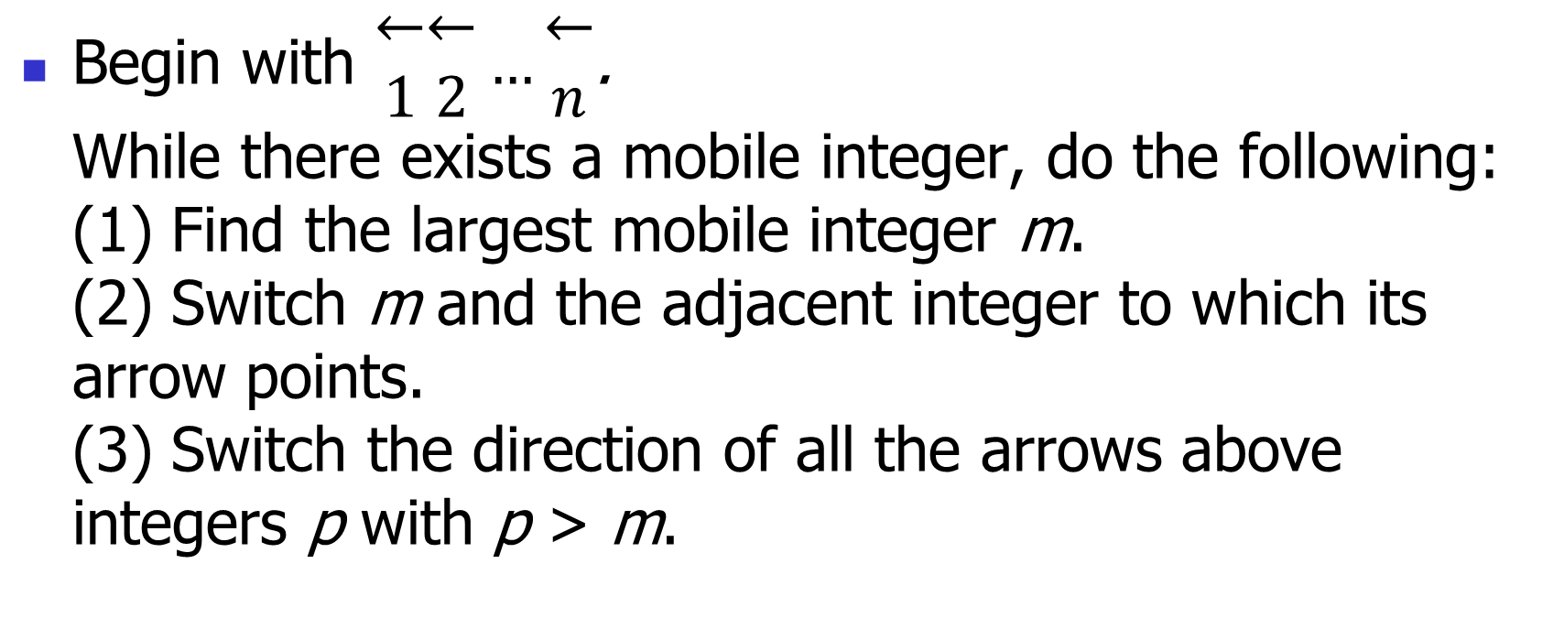
Algorithm for generating the permutations of {1, 2, ... , n}
Begin with $\begin{matrix}← \\ 1\end{matrix}\begin{matrix}← \\ 2\end{matrix}…\begin{matrix}← \\ n\end{matrix}$. While there exists a mobile integer, do the following: (1) Find the largest mobile integer m. (2) Switch m and the adjacent integer to which its arrow points. (3) Switch the direction of all the arrows above integers p with p > m.

Slide 11
How to Understand Mobile Integer
Express the process of the movement of an integers.
Express the relation between the movement and the circumstance.
Mobile integer m moves through the integers smaller than m.
Mobile integer m is not influenced by the integers larger than m.
The algorithm stops when there is no mobile integer.
When there is no adjacent integer in the direction of the arrow of integer m, m is not mobile. This stipulation is not in accordance with “vacuous true”.

Slide 12
Proof
S. Even, Algorithmic Combinatorics, Macmillan, New York (1973).
Basic idea
achieved by induction.
The algorithm is in accordance with the recursive process.
In case n = 2: …
Assume now that the algorithm works for n, and we want to show that this implies its validity for n + 1.

Slide 13
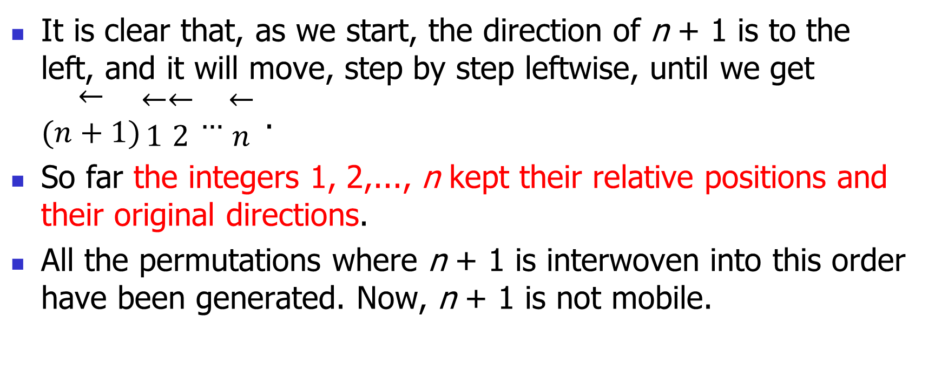
Proof
It is clear that, as we start, the direction of n + 1 is to the left, and it will move, step by step leftwise, until we get $\begin{matrix}← \\ (n+1)\end{matrix}\begin{matrix}← \\ 1\end{matrix}\begin{matrix}← \\ 2\end{matrix}…\begin{matrix}← \\ n\end{matrix}$ .
So far the integers 1, 2,..., n kept their relative positions and their original directions.
All the permutations where n + 1 is interwoven into this order have been generated. Now, n + 1 is not mobile.

Slide 14
Proof
Thus, m is the integer which would be determined if the algorithm were applied to 1, 2,..., n only.
Also, the two integers which switch places are the same as if n + 1 were not there.
Now the direction on n + 1 is switched, and it moves all the way to the right.
Such kind of processes proceeds till the end.
In each process that changes something, there should be something else that does not change, it is called invariant: the principle, the direction, the target, etcetera.

Slide 15
Generating a Random Permutation
generating a random permutation i₁i₂ ... i_{n} of {1, 2, ... , n}
each of the n! permutations has an equal chance, namely 1/n!, of being generated.

Slide 16
Generating a Random Permutation
Let A = {1, 2, ... ,n}.
To choose an integer at random from A (so each of the integers in A has a probability of 1/n of being chosen) and call this integer i₁.
Then remove i₁ from A and choose an integer at random from the remaining n - 1 elements (so now each integer left in A has a probability of 1/(n -1) of being chosen) and call this integer i₂.

Slide 17

Generating a Random Permutation
Continue this process.
Probability of every permutation being chosen is
$\frac{1}{n}∙\frac{1}{n−1}∙\frac{1}{n−2}…\frac{1}{2}∙\frac{1}{1}=\frac{1}{n!}$.

Slide 18
Knuth Shuffle
Start with the identity permutation 12 ... n
sequentially, for each k = 1,2, ... , n - 1, randomly choose one of the positions k, k + 1, ... , n and switch the integers in position k and the chosen position.
How to prove?
The ith step make a decision for the number at position i. Its effect is the same with step i of the preceding method.

Slide 19
4.2 Inversions in Permutations

Slide 20
Inversions in Permutations
Let i₁i₂ ... i_{n} be a permutation of the set {1, 2, ... ,n}. The pair (i_{k}, i_{l}) is called an inversion if k < l and i_{k} > i_{l}.
The only permutation of {1, 2, ... ,n} with no inversions is 12 ... n.
The permutation 31524 has four inversions, namely (3, 1), (3, 2), (5, 2), (5, 4).
For a permutation i₁i₂ ... i_{n}, we let a_{j} denote the number of inversions whose second component is j.
For permutation 31524, a₁ = 1, a₂ = 2, a₃ = 0, a₄ = 1.

Slide 21
Inversion Sequence
a_{j} equals the number of integers that precede j in the permutation but are greater than j;
a_{j} measures how much j is out of order.
a₁ gives complete information of the position of 1.
The sequence of numbers a₁, a₂, … , a_{n} is called the inversion sequence of the permutation i₁i₂ ... i_{n} .
The inversion sequence of the permutation 31524 is 1, 2, 0, 1, 0.
The number a₁ + a₂ + ... + a_{n} measures the disorder of a permutation.

Slide 22
Number of Inversion Sequence
The inversion sequence a₁, a₂, ... , a_{n} of the permutation i₁i₂ ... i_{n} satisfies the conditions
0 <= a₁ <= n - 1, 0 <= a₂ <= n - 2, ... ,
0 <= a_{n-1} <= 1, a_{n} = 0.
Using the multiplication principle, we see that the number of inversion sequence is n!.

Slide 23
Theorem 4.2.1
Let b₁, b₂, ... , b_{n} be a sequence of integers satisfying 0 <= b₁ <= n - 1, 0 <= b₂ <= n - 2, ... ,
0 <= b_{n-1} <= 1, b_{n} = 0. Then there exists a unique permutation of {1, 2, ... ,n}
whose inversion sequence is b₁, b₂, ... , b_{n}.

Slide 24
Construction of a Permutation from Its Inversion Sequence
Algorithm II
1: Since there are to be b₁ integers that precede 1 in the permutation, we must put 1 in location number b₁ + 1.
2: Since there are to be b₂ integers that precede 2 and are larger than 2 in the permutation, and since these integers have not yet been inserted, we must leave exactly b₂ empty locations for them. Thus, counting from the left, we put 2 in the (b₂ + 1)st empty location.
k: (general step) put k in the (b_{k} + 1)st such empty location.
…
n: We put n in the one remaining empty location.
Absolute position.

Slide 25
Construction of a Permutation from Its Inversion Sequence
Algorithm I
n: Write down n.
n - 1: Consider b_{n-1} . We are given that 0 <= b_{n-1} <= 1. If b_{n - 1} = 0, then n - 1 must be placed before n. If b_{n - 1} = 1, then n - 1 must be placed after n.
n - 2: Consider b_{n-2}. We are given that 0 <= b_{n-2} <= 2. If b_{n-2} = 0, then n - 2 must be placed before the two numbers from step n - 1. If b_{n-2} = 1, then n - 2 must be placed between the two numbers from step n - 1. If b_{n-2} = 2, then n - 2 must be placed after the two numbers from step n - 1.

Slide 26
Construction of a Permutation from Its Inversion Sequence
Algorithm I
n - k: (general step), 0 <= b_{n-k} <= k. To place n - k after the b_{n-k}st number in the sequence constructed in the previous step.
…
1: We must place 1 after the b₁st number in the sequence constructed in the previous step.
the relative positions of the integers remain fixed throughout the algorithm.
The disadvantage of this algorithm is that the location of each integer in the permutation is not known until the very end;

Slide 27
Example
Determine the permutation of {1, 2, 3, 4, 5, 6, 7, 8} whose inversion sequence is 5,3,4,0,2,1,1,0.
Application of the preceding two algorithms.

Slide 28
One-to-One Correspondence between a Permutation and the Inversion Sequence.
It follows from Theorem 4.2.1 that the correspondence which associates the inversion sequence to each permutation is a one-to-one correspondence between the permutations of {1, 2, ... , n} and the sequences of integers b₁ , b₂, ... , b_{n} satisfying 0 <= b₁ <= n - 1, 0 <= b₂ <= n - 2, ... ,
0 <= b_{n-1} <= 1, b_{n} = 0.

Slide 29
Transfer of a Permutation to Its Natural Sequence by Switches of Adjacent Numbers
If the permutation i₁i₂ ... i_{n} has inversion sequence b₁, b₂, ... , b_{n} , and k = b₁ + b₂ + ... + b_{n} is the number of inversions, then i₁i₂ ... i_{n} can be brought to 12 ... n by k successive switches of adjacent numbers.
Compare this process with that one of algorithm II. (Illustration with the previous example.)
We first switch 1 successively with the b₁ numbers to its left.
We then switch 2 successively with the b₂ numbers to its left which are greater than 2, and so on.
In this way, we arrive at 12 ... n after b₁ + b₂ + ... + b_{n} switches.

Slide 30
Transfer of a Permutation to Its Natural Sequence by Switches of Adjacent Numbers
How does a switch of adjacent numbers influence the inversion numbers of the numbers in the permutation?
one instance of a sorting procedure

Slide 31
4.3 Generating Combinations

Slide 32
Generating Combinations
S= {x_{n-1}, … , x₁, x₀}.
We want a systematic procedure that lists all 2^{n} subsets of S.
Given a subset A of S, then each element x either belongs or does not belong to A.
If we use 1 to denote that an element belongs and 0 to denote that an element does not belong, then we can identify the 2^{n} subsets of S with the 2^{n} n-tuples.

Slide 33
Basic Idea
Representing the 2^{n} subsets with base 2 numeral.
We let the ith term a_{i} of the n-tuple correspond to the element x_{i} for each i = 0, 1, ... , n - 1.
(a_{n-1}, … , a₁, a₀) = a_{n-1}… a₁a₀

Slide 34
Representing the 2^{n} Subsets with Base 2 Numeral
In general, given an integer m from 0 up to 2^{n} - 1, it can be expressed in the form
where each a_{i} is 0 or 1.
between 0 and 2^{n} - 1.
We need an orderly process: what kind of order?

Slide 35
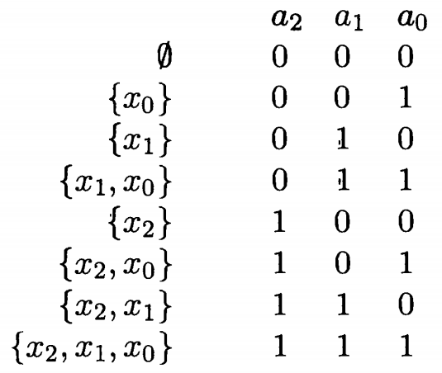
Lexicographic Ordering of Binary n-tuples.
Example

Slide 36
Base 2 Algorithm for Generating the Subsets of {x_{n-1}, … , x₁, x₀}
Basic idea
Rule of base 2 addition: carry.
Begin with a_{n-1}… a₁a₀ = 0···00. While a_{n-1}… a₁a₀ <> 1···11, do the following: (1) Find the smallest integer j (between n - 1 and 0) such that a_{j} = 0. (2) Replace a_{j} with 1 and replace each of a_{j-1}, ... , a₀ (which, by our choice of j, all equal 1) with 0.

Slide 37
Lexicographic Ordering of Binary n-tuples.
In this ordering, an n-tuple a_{n-1}… a₁a₀ occurs earlier on the list than another n-tuple b_{n-1}… b₁b₀ provided that, starting at the left, the first position in which they disagree, say position j, we have a_{j} = 0 and b_{j} = 1.
Lexicographic order and the increasing order.

Slide 38
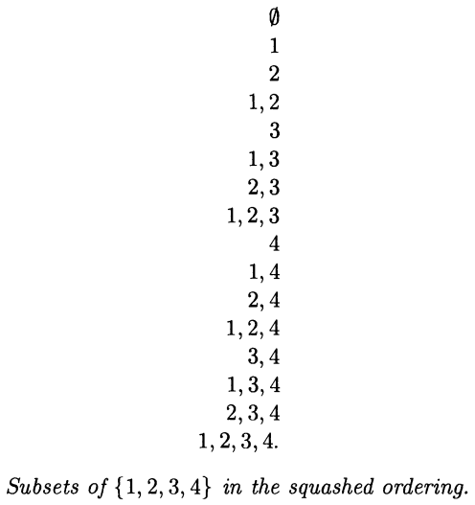
Squashed Ordering of Subsets.
Lexicographic order of n-tuples = squashed ordering of subsets.
Squashed ordering of subsets: To list all the subsets of the current elements before introducing a new element.
Smaller n-tuples first

Slide 39
Gray Code
Is it possible to generate the subsets of a set of n elements in a different order so that the immediate successor of a subset differs from it as little as possible?
by either including a new element or deleting an old element, but not both; in short, one in or one out.

Slide 40
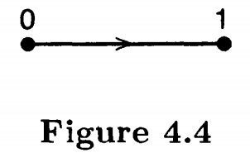
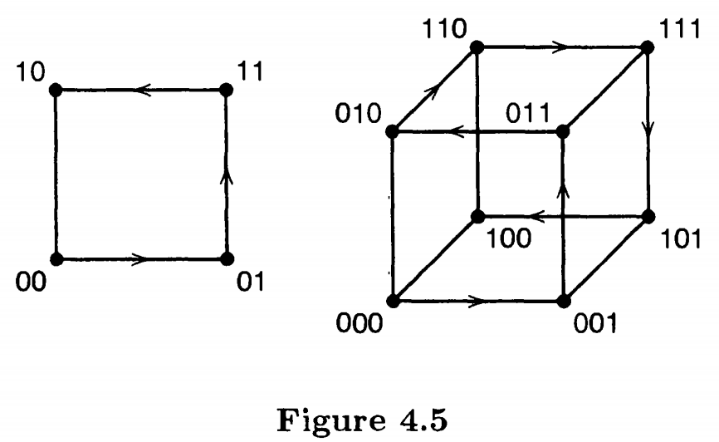
A Geometric Identification of Reflected Gray Code
We regard an n-tuple of 0s and 1s as the coordinates of a point in n-dimensional space.
Change independently.
Gray code of order n: n-tuples of 0s and 1s which has the property that the successor of an n-tuple differs from it in only one place corresponds to a walk along the edges of an n-cube that visits every corner exactly once.
The unit n-cube (a 1-cube is a line segment, a 2-cube is a square, a 3-cube is an ordinary cube)
Parity of the corners.

Slide 41
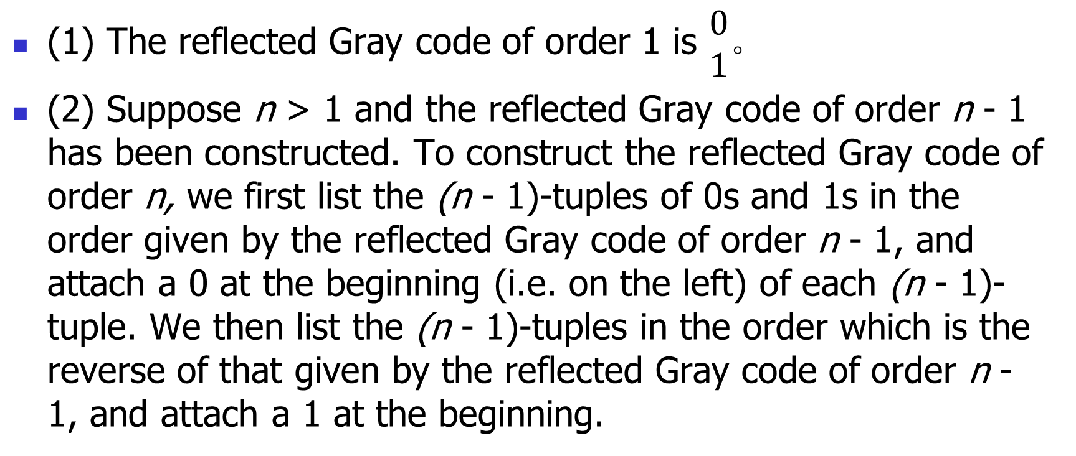
Inductive Definition of the Reflected Gray Code of Order n
(1) The reflected Gray code of order 1 is $\begin{matrix}0 \\ 1\end{matrix}$。
(2) Suppose n > 1 and the reflected Gray code of order n - 1 has been constructed. To construct the reflected Gray code of order n, we first list the (n - 1)-tuples of 0s and 1s in the order given by the reflected Gray code of order n - 1, and attach a 0 at the beginning (i.e. on the left) of each (n - 1)-tuple. We then list the (n - 1)-tuples in the order which is the reverse of that given by the reflected Gray code of order n - 1, and attach a 1 at the beginning.

Slide 42
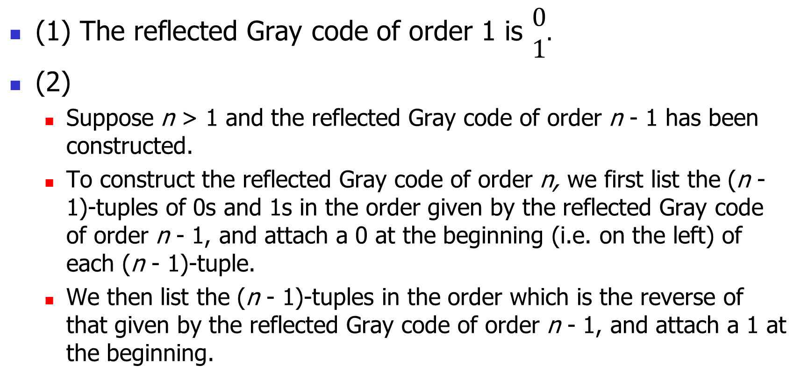
An Inductive Algorithm
(1) The reflected Gray code of order 1 is $\begin{matrix}0 \\ 1\end{matrix}.$
(2)
Suppose n > 1 and the reflected Gray code of order n - 1 has been constructed.
To construct the reflected Gray code of order n, we first list the (n - 1)-tuples of 0s and 1s in the order given by the reflected Gray code of order n - 1, and attach a 0 at the beginning (i.e. on the left) of each (n - 1)-tuple.
We then list the (n - 1)-tuples in the order which is the reverse of that given by the reflected Gray code of order n - 1, and attach a 1 at the beginning.

Slide 43
Trying to Find the Patterns of the Walk for Non Inductive Algorithm
Sequence of dimensions.
Traverse from the lower dimension
Sequence of the number of dimension in a walk
1213121 for 3 dimension
121312141213121 for 4 dimension
Move on dimension 1 from the tuples with even parity：change the rightest bit
And move on the other dimensions from the tuples with odd parity: higher or lower

Slide 44
Transition from Corners with Odd Parity
The pattern of corners from which to go to a higher dimension
Ending on a lower dimension and goes to higher dimension from 0100…0
cyclic : to traverse one more edge to get from the terminal corner to the initial corner of the walk.
From the highest dimension
for tuple b_{n}…b₀ with odd parity, determine j such that b_{j} = 1 and b_{i} = 0 for all i with j > i (i.e., the first 1 from the right), and b_{j+1} = 0
0001, 0010, 0100, 1101
Go back from a higher dimension:
0111, 1110, 1011
Their symmetric transition

Slide 45
Symmetry
symmetric transitions
0001,0011; 1011,1001：Step 2 and step next to the last
0010,0110; 1110,1010
0111,0101; 1101,1111
Pattern of symmetric transitions
b_{n-2}…b₀, a_{n-2}…a₀, 1a_{n-2}…a₀, 1b_{n-2}…b₀
determine j such that b_{j} = 1 and b_{i} = 0 for all i with j > i (i.e., the first 1 from the right), and then change b_{j+1} (from 0 to 1 or 1 to 0).

Slide 46
An Algorithm Based on Rule of Succession
Begin with the n-tuple a_{n-1}a_{n-2} …a₀ = 00...0.
While the n-tuple a_{n-1}a_{n-2} …a₀ <> 10···0, do the following:
(1) Compute σ(a_{n-1}a_{n-2} …a₀) = a_{n-1} + a_{n-2} + … + a₀. which is the number of its 1s .
(2) If σ(a_{n-1}a_{n-2} …a₀) is even, change a₀ (from 0 to 1 or 1 to 0).
(3) Else, determine j such that a_{j} = 1 and a_{i} = 0 for all i with j > i (i.e., the first 1 from the right), and then change a_{j+1} (from 0 to 1 or 1 to 0).

Slide 47
Theorem 4.3.1
The preceding algorithm for generating the n-tuples of 0s and 1s produces the reflected Gray code of order n for each positive integer n.
Proof
by induction on n.
when n=1: …
Let n > 1, and assume that the algorithm applied to n - 1 produces the reflected Gray of order n - 1.

Slide 48
Theorem 4.3.1(Proof Continued)
The first 2^{n-1} n-tuples of the reflected Gray code of order n consist of the (n - 1)-tuples of the reflected Gray code of order n - 1 with a 0 attached at the beginning of each (n - 1)-tuple.
Since the (n - 1)-tuple 10· ··0 occurs last in the reflected Gray code of order n - 1, it follows that the rule of succession applied to the first (2^{n - 1} - 1) n-tuples of the reflected Gray code of order n has the same effect as applying the rule of succession to all but the last (n - 1)-tuple of the reflected Gray code of order n – 1 and then attaching a 0.

Slide 49
Theorem 4.3.1(Proof Continued)
Hence it is a consequence of the inductive hypothesis that the rule of succession produces the first half of the reflected Gray code of order n.
The 2^{n-1}st n-tuple of the reflected Gray code of order n is 010...0. Since σ(010...0) = 1, an odd number, the rule of succession applied to 010...0 gives 110…0, which is the (2^{n-1} + 1)st n-tuple of the reflected Gray code of order n.

Slide 50
Theorem 4.3.1(Proof Continued)
Begin with the 2^{n-1}st and (2^{n-1}+1)st n-tuple, check the n-tuples at the symmetrical position step by step.
010...0 at position 2^{n-1}
110…0 at position 2^{n-1}+1
Consider now two consecutive (n - 1)-tuples in the first half of the reflected Gray code of order n - 1:
b_{n-2}…b₀
a_{n-2}…a₀
Then 1a_{n-2}…a₀ is at the symmetric position of a_{n-2}…a₀, and is immediately followed by 1b_{n-2}…b₀ in the reflected Gray code of order n.
1a_{n-2}…a₀
1b_{n-2}…b₀

Slide 51
Theorem 4.3.1(Proof Continued)
Now σ(a_{n-2}…a₀ ) and σ(b_{n-2}…b₀) are of opposite parity. One is even and the other is odd.
Also, σ(1a_{n-2}…a₀ ) and σ(a_{n-2}…a₀ ) are of opposite parity,
and so are σ(1b_{n-2}…b₀ ) and σ(b_{n-2}…b₀).
Suppose that σ(b_{n-2}…b₀) is even.
…
b_{n-2}…b₀
a_{n-2}…a₀
1a_{n-2}…a₀
1b_{n-2}…b₀

Slide 52
4.4 Generating r-Subsets

Slide 53

Example
We need an orderly solution.
Assign a total order to objects of the set.
Inductive thinking:
the 2-subsets of {1, 2, 3, 4}
2-subsets of {1, 2}, and then that of {1, 2, 3}, and then that of {1, 2, 3, 4}.
Hard to find any useful regular patterns.

Slide 54
Another Order: Lexicographic Order of Subsets
Then we say that A precedes B in the lexicographic order provided that the smallest integer which is in their union A ∪B, but not in their intersection A ∩ B (that is, in one but not both of the sets), is in A.
One to one correspondence between a subsets and its enumeration in ascending order.
{12,13,14,23,24,34}
Lexicographic order = numerical order
Basic Idea
Incrementally enumerate all numbers of length r, from the least to the most.

Slide 55
Case Study
12567
13456
13457
13467
13567
14567
23456
23457
23467
23567
24567
34567
Generate 5-subsets of the set {1, 2, …, 7}
12345
12346
12347
12356
12357
12367
12456
12457
12467

Slide 56
Theorem 4.4.1
Let a₁a₂…a_{r} be an r-subset of {1, 2, ... , n}.
The first r-subset in the lexicographic ordering is 12...r.
The last r-subset in the lexicographic ordering is (n-r+1)(n-r+2)…n.
Assume that a₁a₂…a_{r} <> (n-r+1)(n-r+2)··· n.
Let k be the largest integer such that a_{k} < n and a_{k} + 1 is different from each of a_{k+1}, …, a_{r}.
Then the r-subset that is the immediate successor of a₁a₂…a_{r} in the lexicographic ordering is
a₁…a_{k-1} (a_{k} +1) (a_{k} +2)…(a_{k} + r - k - 1)

Slide 57
Theorem 4.4.1(Proof)
It follows from the definition of the lexicographic order that 12 ... r is the first and (n - r + 1)(n - r + 2) ... n is the last r-subset in the lexicographic ordering.
Now let a₁a₂…a_{r} be any r-subset other than the last, and determine k as indicated in the theorem.
Then
where a_{k} + 1 < n - r + k + 1.

Slide 58
Theorem 4.4.1
Thus a₁a₂…a_{r} is the last r-subset that begins with a₁...a_{k-1}a_{k}.
The r-subset
is the first r-subset that begins a₁ ... a_{k-1}(a_{k} + 1) and hence
is the immediate successor of a₁a₂…a_{r}.

Slide 59
Algorithm for Generating the r-subsets in Lexicographic order
Generate the r-subsets of {1,2, ... , n}
Begin with the r-subset a₁a₂…a_{r} = 12 ···r.
While a₁a₂…a_{r} <> (n - r + 1)(n - r + 2) ... n, do the following:
(1) Determine the largest integer k such that a_{k} + 1 <> n and a_{k} + 1 is not one of a₁, a₂ , … , a_{r} .
(2) Replace a₁a₂…a_{r} with the r-subset

Slide 60
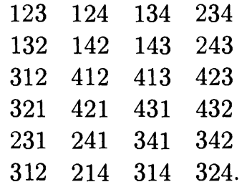
Generating r-permutations of an n-element Set(An Example)
Combining the algorithm for generating permutations of a set with that for generating r-subsets of an n-element set, we obtain an algorithm for generating r-permutations of an n-element set.
Generate the 3-permutations of
{1, 2, 3, 4} .

Slide 61
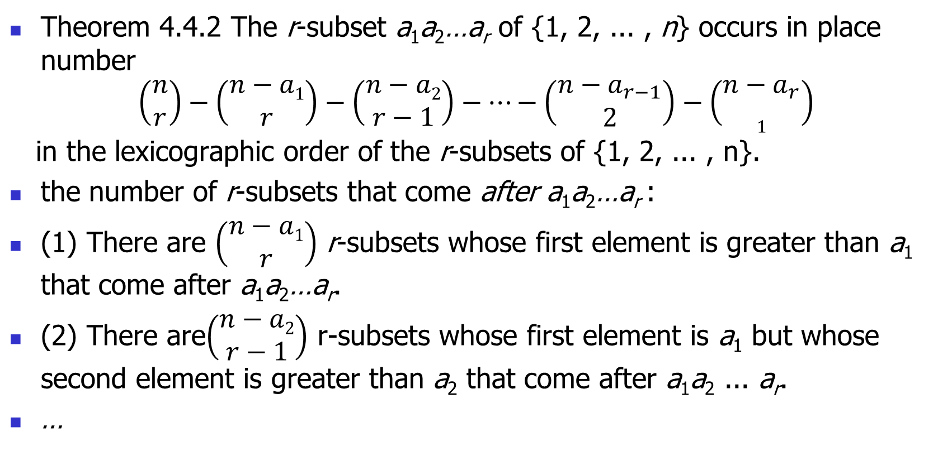
Determining the Position of Each r-subset in the Lexicographic Order
Theorem 4.4.2 The r-subset a₁a₂…a_{r} of {1, 2, ... , n} occurs in place number
$$\left(\begin{matrix}n \\ r\end{matrix}\right)−\left(\begin{matrix}n−a1 \\ r\end{matrix}\right)−\left(\begin{matrix}n−a2 \\ r−1\end{matrix}\right)−…−\left(\begin{matrix}n−a_{r−1} \\ 2\end{matrix}\right)−\left(\begin{matrix}n−a_{r} \\ 1\end{matrix}\right)$$
in the lexicographic order of the r-subsets of {1, 2, ... , n}.
the number of r-subsets that come after a₁a₂…a_{r} :
(1) There are $\left(\begin{matrix}n−a1 \\ r\end{matrix}\right)$ r-subsets whose first element is greater than a₁ that come after a₁a₂…a_{r}.
(2) There are$\left(\begin{matrix}n−a2 \\ r−1\end{matrix}\right)$ r-subsets whose first element is a₁ but whose second element is greater than a₂ that come after a₁a₂ ... a_{r}.
…

Slide 62
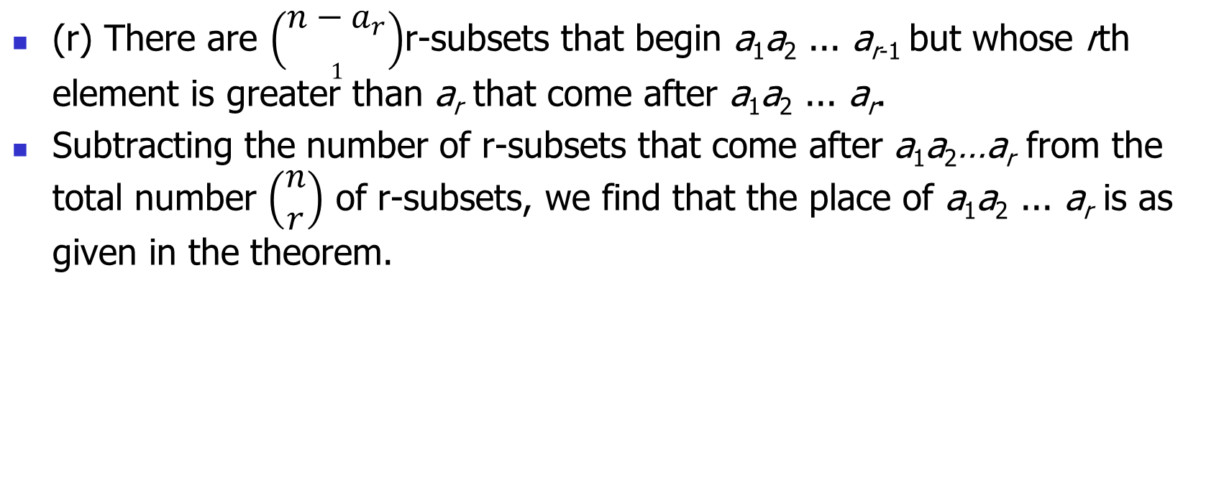
Proof
(r) There are $\left(\begin{matrix}n−a_{r} \\ 1\end{matrix}\right)$r-subsets that begin a₁a₂ ... a_{r-1} but whose rth element is greater than a_{r} that come after a₁a₂ ... a_{r}.
Subtracting the number of r-subsets that come after a₁a₂…a_{r} from the total number $\left(\begin{matrix}n \\ r\end{matrix}\right)$ of r-subsets, we find that the place of a₁a₂ ... a_{r} is as given in the theorem.

Slide 63
Exercises
自己过一遍，不需要做到作业本上
Generating Permutations：3,
Base 2 Arithmetic Generating Scheme: 13,
Reflected Gray Code: 21,
Generation of r-subset: 27
上交的作业
Generating Permutations： 1, 4, 5,
Inversions in Permutations: 6, 7, 8(a, b, c), 9,
Base 2 Arithmetic Generating Scheme: 15, 16, 17,
Reflected Gray Code: 18, 23, 24,
Generation of r-subset: 26, 28, 34

